Slide 1
What’s Happening at the IETF & IRTF?
18 September 2017
Human Rights Protocol Considerations
and how to get involved
Salam Yamout
Middle East Bureau Director
meynell@isoc.org

Slide 2
Disclaimer
Two important points:
No-one really speaks for the IETF or IRTF
I am speaking about the IETF or IRTF as an individual participant
https://trac.tools.ietf.org/group/iesg/trac/wiki/SpeakingForIetf

Slide 3
IETF Standards make the Internet work
TCP/IP
IPv4 (RFC791) and IPv6 (RFC2460…)
TCP (RFC675…) and UDP (RFC768)
E-Mail
SMTP (RFC5321), IMAP (RFC3501)
Network and Routing
BGP (RFC4271), OSPF (RFC2178…), MPLS (RFC3031)
DNS
DNS (RFCs 1034, 1035…)
DNSSEC (RFCs 4033, 4034 & 4035)
DANE (RFCs 6698, 7671…)
Web
HTTP (RFC2616…)
Security
TLS (RFCs 5246 & 6176)

Slide 4
IETF Areas - http://www.ietf.org/iesg/area.html
Applications and Real-Time (ART)
Transport (TSV)
Security (SEC)
General (GEN)
Application protocols and architectures
Real-time (and non-real-time) communication
Network management
Operations: IPv6, DNS, security, routing
Security protocols and mechanisms, including cryptography
Activities focused on supporting and updating IETF processes
Internet (INT)
Operations and Management (OPS)
IPv4/IPv6, DNS, DHCP, VPNs, mobility
Mechanisms related to data transport on the Internet
Congestion control
Routing (RTG)
Routing and signalling protocols

Slide 5
Internet Research Task Force
Considers long-term research issues related to the Internet
IRTF Chair & Research Group Chairs form Internet Research Steering Group (IRSG)
Publishes RFCs in IRTF Stream
Current Research Groups:
Crypto Forum (CFRG)
Thing-to-Thing (T2TRG)
Internet Congestion Control (ICCRG)
Measurement & Analysis (MAPRG)
Network Function Virtualisation (NFVRG)
Network Management (NMRG)
Information-Centric Networking (ICNRG)
Network Coding (NWCRG)
Global Access to the Internet for All (GAIA) – Jane Coffin (Chair)
Human Rights Protocol Considerations (HRPC)

Slide 6
Participating in IETF & IRTF
https://www.ietf.org/ and https://www.irtf.org
Anyone can participate in the mailing lists and discussions
Anyone can submit a ‘draft’ document (known as an Internet Draft or I-D)
Working Groups and Research Groups debate and discuss drafts
Documents progress through the standards process to become RFCs
Primary venue for all communication is e-mail

Slide 7
Impact of Internet Protocols on Human Rights
UN Human Rights Council 2012 – affirms rights defined in Article 19 of Universal Declaration of Human Rights and International Covenant on Civil and Political Rights must be protected online
UN General Assembly 2013 – calls upon all States to respect the right to privacy in digital communication
UN Special Rapporteur FoE 2015 - governments should promote use of strong encryption and protect anonymous expression online
UN Special Rapporteur FoE 2016 – private entities should integrate commitments to freedom of expression into product engineering, policies and standards

Slide 8
IRTF Human Rights Protocol Considerations
IRTF Human Rights Protocol Considerations Research Group established in Jan 2015
Researching whether standards and protocols can enable or threaten human rights
Can the human rights characteristics of the Internet be degraded if not properly defined, described and sufficiently taken into account udring rotocol development.
Open, secure and reliable connectivity is essential for rights such as freedom of expression and freedom of association.

Slide 9
RFC 6973: Privacy Considerations for Internet Protocols
Entry point for this work
Offers guidance for developing privacy considerations for inclusion in protocol specifications.
Aims to make designers, implementers, and users of Internet protocols aware of privacy-related design choices.
Suggests that whether any individual RFC warrants a specific privacy considerations section will depend on the document's content.
Builds on previous body of security analysis by recognizing the threats to privacy are security threats

Slide 10
Research into Human Rights Protocol Considerations draft-irtf-hrpc-research-14
Informational document with consensus from IRTF HRPC Research Group
Aims to offers guidelines similar to RFC 6973 (privacy considerations)
Outlines human rights threats on the Internet
Consider how well-known Internet protocols (e.g. DNS, NAT and HTTP) can have human rights concerns
Considers implications of traffic interception, manipulation, throttling, logging, tracking, and DDoS on human rights

Slide 11
Research into Human Rights Protocol Considerations draft-irtf-hrpc-research-14
Provides guidelines in 19 areas such as privacy and confidentality, but also:
Connectivity: is end-to-end connectivity supported, do protocols support low bandwidth and high latency, can protocols operate in a stateless manner?
Content agnosticism: is all network traffic delivered in a non-discriminatory way?
Authenticity: can receiver be sure data comes from the source it claims to come from?
Internationalisation: are protocols, standards, and implementations usable in different languages and scripts?
Censorship resistance: do protocols introduce new identifiers that can be associated with persons or content?
Open standards: are protocol specifications published, and their functioning known?

Slide 12
Other HRPC RG Drafts
Freedom of Association on the Internet (draft-tenoever-hrpc-association-02)
Scope the relationship between Internet protocols and the right to freedom of assembly and association
On the Politics of Standards (draft-tenoever-hrpc-political-02)
Outline different views on the relation between protocols and politics, and whether protocols are political
Unrequested Communications (draft-tenoever-hrpc-unrequested-00)
Addresses issue of unrequested traffic in the form of spam or DDoS attacks

Slide 13
Next Meeting: IETF 100
11-17 November 2017, Singapore
https://www.ietf.org/meeting/100/
HRPC RG meeting
Friday 17 Nov 2017 (0900-1130 UTC+8)
Remote participation available:
Audio streams
Web conferencing systems
Jabber chat rooms

Slide 14
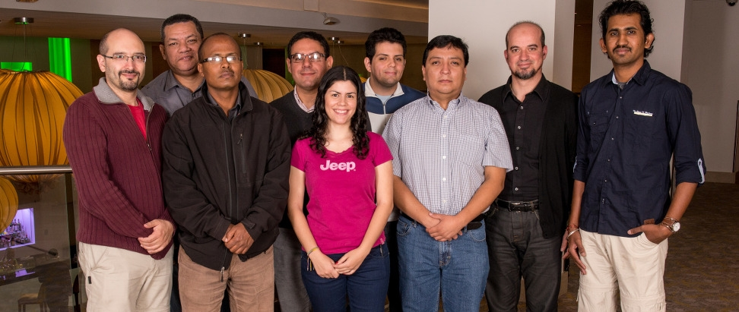
IETF Fellowship Programme
Fellowships available to enable people to attend IETF meetings
http://www.internetsociety.org/what-we-do/education-and-leadership-programmes/ietf-and-ois-programmes/internet-society-fellowship

Slide 15
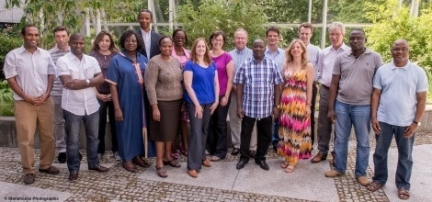
IETF Policy Programme
Fellowships available for regulators to attend IETF meetings and learn about IETF standards and processes
https://www.internetsociety.org/what-we-do/education-and-leadership-programmes/ietf-and-ois-programmes/internet-society-fellowship-5

Slide 16
Summary
The IETF and IRTF makes the Internet work better
It has a fundamental role in Internet administration
It has international scope, but local relevance
It has an open, inclusive and well-established structure
Your participation is critical to the success
More information:
http://www.ietf.org/newcomers.html

Slide 17
http://www.internetsociety.org/deploy360/ deploy360@isoc.org

