Slide 1
OTA & IoT A Shared & Collaborative Responsibility 24 October 2017

Slide 2
Online Trust Alliance
Founded as Industry Trade Organisation in 2007
65 members (e.g. DigiCert, Symantec, Verisign, Microsoft, Twitter, Coles)
Internet Society and OTA merged in April 2017, with OTA members becoming ISOC members
Objectives and Activities:
Promote best practices in protection of user security, privacy and identity, including data stewardship
Develop meaningful self-regulation

Slide 3
IoT Challenges (starting with my house)
Cable modem, router, switch
2 x WiFi access points
2 Apple Macs, 2 PCs
iPhones (4), iPads (6), Android phone
1 x Synology RAID server (multimedia, backup and security)
1 x network printer
Smart televisions (2), multimedia systems (2), gaming controller (1)
Home security devices – security cameras (2), burglar alarm, smoke and fire sensors
Home automation – would like to add lighting and temperature controls
At least 30 devices in use

Slide 4
What is going on?
I’m a reasonably astute technical user;
I bought devices that support SSL/TLS management, IPv6, configurable security, and encrypted data transmission + storage;
and, I have an idea how to do network monitoring
BUT
I’m time poor, not at home much, and can’t monitor everything
I’ve little/no idea who these devices are communicating with, and who is communicating with them
I’ve little/no idea what data is being collected, and where it’s going
Many devices have stopped being supported (usually 1-2 years)
Some of the ‘secure’ aspects have been deprecated (e.g. TLSv1)

Slide 5
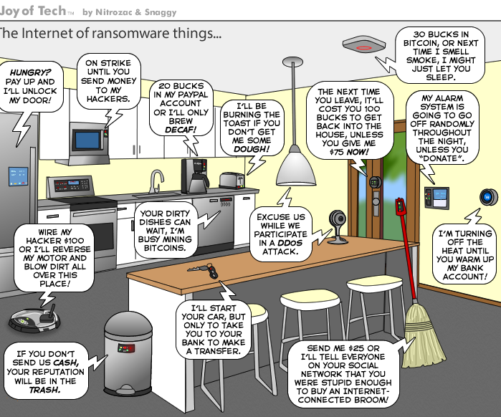

Slide 6
Something must be done!
But there are ~40 different IoT industry bodies!
OTA decided to take broad multi-stakeholder approach to assess IoT risks, and address security, privacy and life-cycle sustainability in IoT products and services
OTA’s IoT Trustworthy Working Group (ITWG) was established in January 2015, chartered with development of an IoT Trust Framework
Consultation with more than 100 device manufacturers, major retailers, security and private experts, consumer testing and advocacy organisations, and governments
Published IoT Security & Privacy Trust Framework in March 2016, updated several times, latest version (v2.5) released June 2017

Slide 7
OTA IoT Security & Privacy Trust Framework
40 principles in 4 key areas to secure IoT devices and their data:
Security – ensure devices use cryptographic protocols by default, only open physical and virtual ports and services that are required, regular monitoring of security settings, verifiable patches
User Access & Credentials – strong authentication, storing of credentials, and anti-brute forcing measures
Privacy, Disclosure & Transparency – what data is being transferred, only collecting data with affirmative user support, disclose end-of-life security and patch support
Notifications – sending authenticated messages to users
https://otalliance.org/system/files/files/initiative/documents/iot_trust_framework6-22.pdf

Slide 8
Okay, but so what?
Other IoT frameworks exist (e.g. OWASP, IOTSF), but tend to focus on specific areas like interoperability and security
OTA is arguably the only holistic IoT framework, although has overlaps with many of the others
Talking with several leading manufacturers and suppliers who are agreed in principle, but still some legalities to resolve
Several large retailers are planning to use OTA framework as filter for carrying products
Working with consumer testing and review organisations – probably initially producing rankings than certification programmes
Framework is conformant with NTIA IoT Multistakeholder recommendations

Slide 9
More Information
IoT Resources https://otalliance.org/IoT
Industry https://otalliance.org/IoTindustry
Consumer https://otalliance.org/IoTconsumer
Online Trust Honor Roll https://otalliance.org/HonorRoll
Join ISOC/OTA https://otalliance.org/membership

