Slide 1
The RIPE Programme Committee
RIPE 75
Dubai, UAE

Slide 2
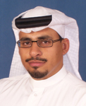
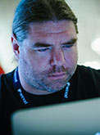
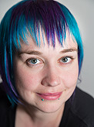
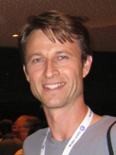
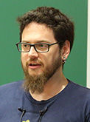
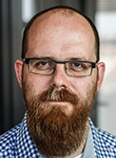
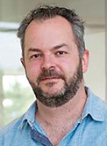
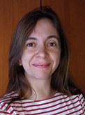
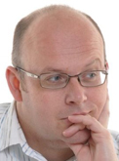
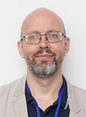
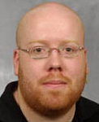
The RIPE Progamme Committee
Osama Al-Dosary
MENOG Repr.
Jan Žorž
SEE Repr.
Leslie Carr
Benno Overeinder
Peter Hessler
Ondřej Surý
Khalid Samara
Host Repr.
Jelte Jansen
Franziska Lichtblau
Maria Isabel Gandía
Mike Hughes
Alex Semenyaka
ENOG Repr.
Brian Nisbet
WG Repr.

Slide 3
Plenary, Tutorials, BoFs
Plenary programme (Sun, Mon, Thu)
16 plenary presentations
9 lightning talks
Tutorials
Sunday morning tutorials (9:00–11:00)
BoFs/workshops
Evening sessions (18:00–19:00)
Rate the talks, tutorials and BoFs!

Slide 4
RIPE PC Elections
Two PC seats up for election (every RIPE meeting)
Nominations open until Monday, 15:30
email nominations to pc@ripe.net
Candidates can present themselves at the start of the Monday, 16:00 session
RIPE PC online voting (w/ RIPE NCC Access)
from Monday, 16:00
until Wednesday, 17:30

