Slide 1
Introducing an almost reliable UDP protocol:
The Keyed UDP
RIPE NCC
Dubai
22-26 October 2017
Nuno M. Garcia, PhD
Coordinator of Assisted Living Computing and Telecommunications Laboratory
Chair of COST Action IC 1303

Slide 2
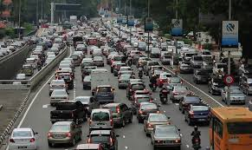
Does this looks familiar?

Slide 3
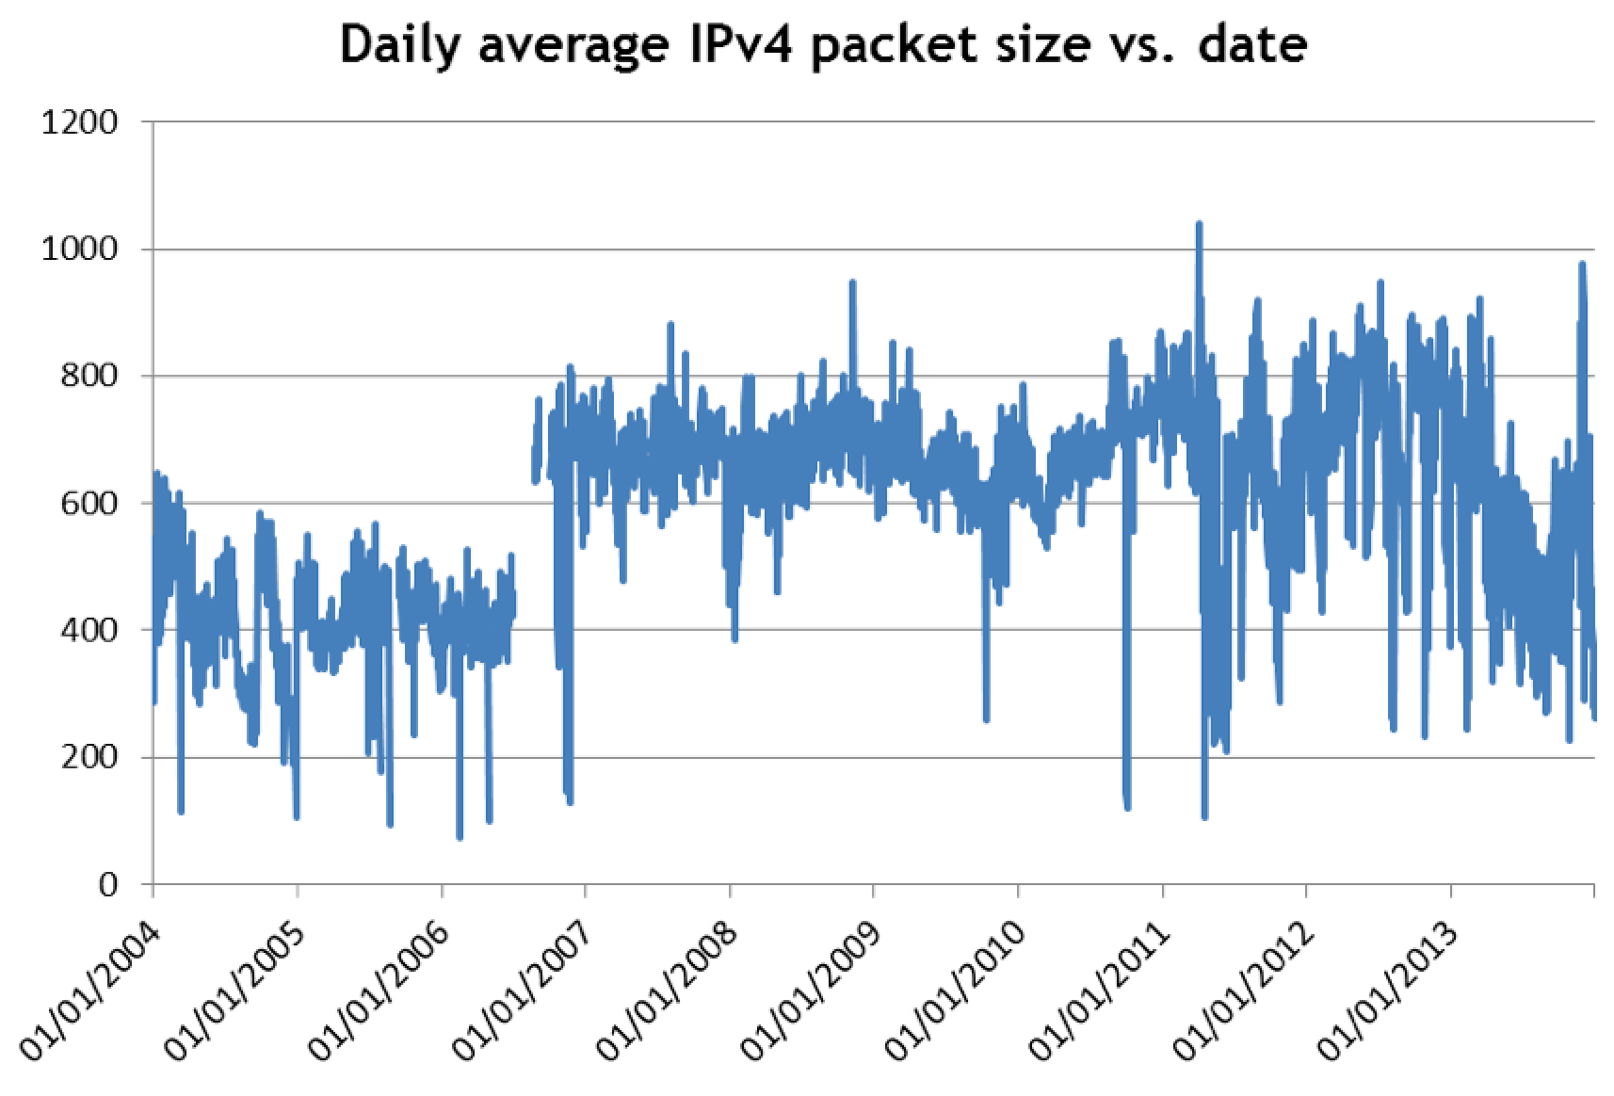
What about this?

Slide 4
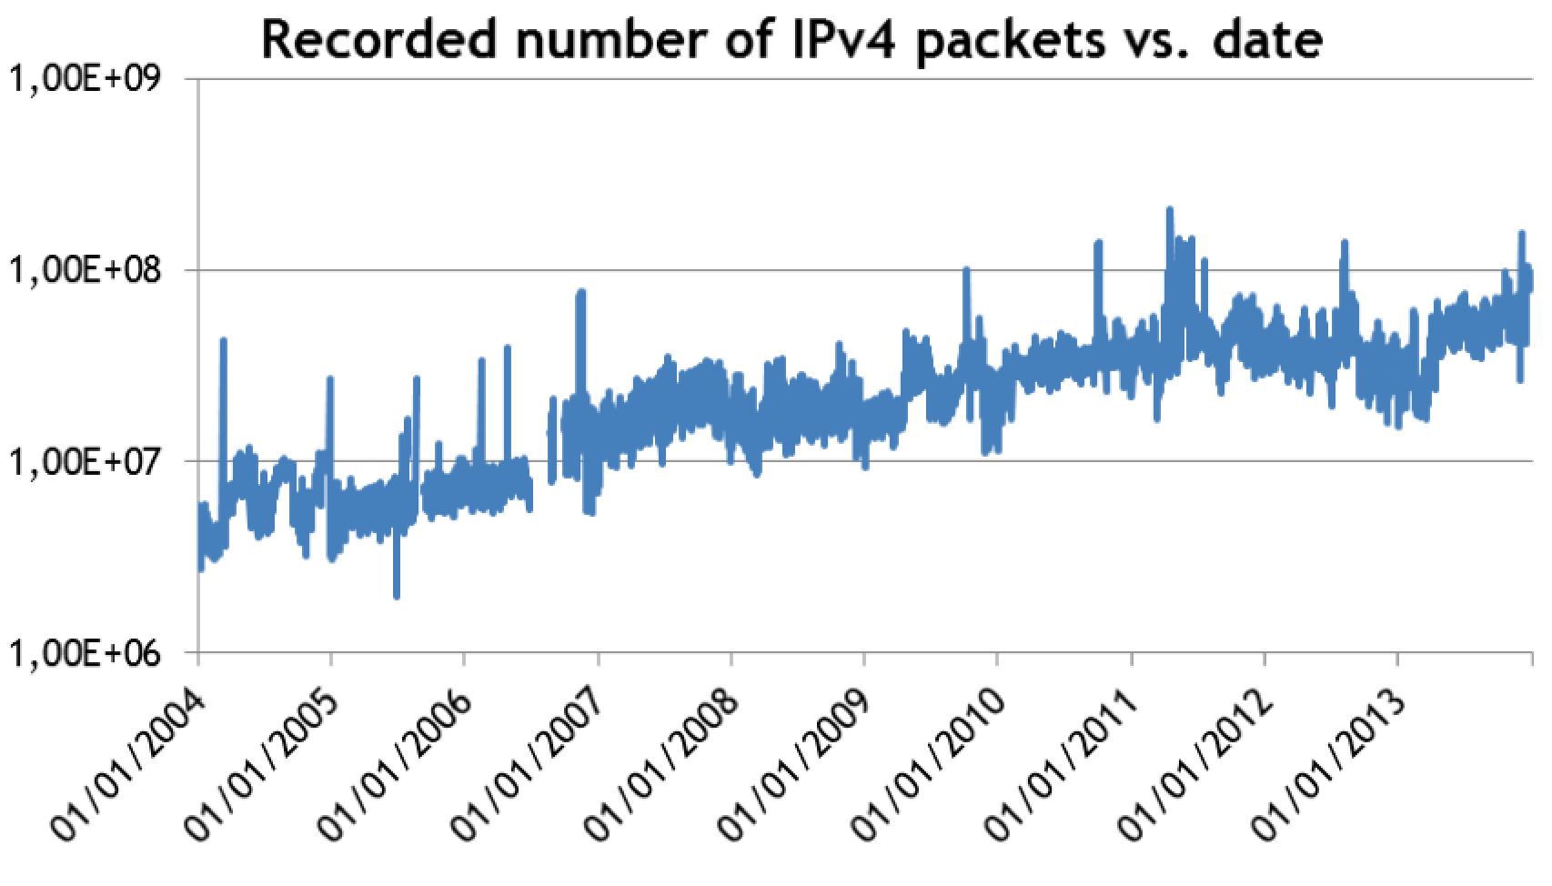
Quick overview of the Internet traffic in the last 10 years

Slide 5
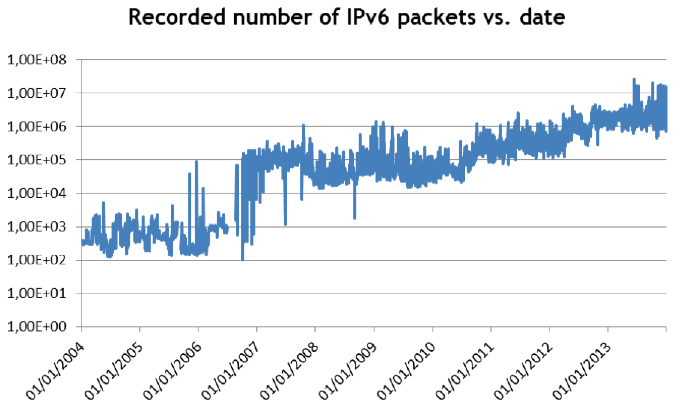
evolution++

Slide 6
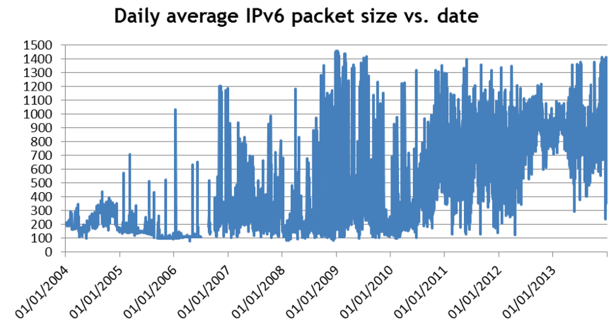
evolution++

Slide 7
And what about applications?
We have witnessed:
  more social media
  more Cloud
  more X as a Service
    (virtualization of desktop on the User Side Resources to the Cloud - why?)

Slide 8
Applications in the future
What can we expect to see in the future?
  mobile phones now host octacores
  mobile operators sell data packets
  every device has some Web App or some Internet service connection (e.g. problems with hacked cars)
  my wristwatch monitors me, my car monitors me, my TV monitors me, my refrigerator monitors everyone, …
  “every device will be a screen to The One” (Kevin Kelly, The first 5000 days of the Web)

Slide 9
Applications in the future
User driven (social media, games, apps…)
Government driven (eGovernment, eCitizenship, …)
Corporations driven (eCustomer)
Machine driven (P2P, machines that are Internet connected)
Open source hardware (Arduíno, Raspberry Pi-Like, etc.)
Open source software (Linux, Python, etc.)

Slide 10
What can we expect?

Slide 11
What can we do?
Problem 1: The Ethernet payload limit (99.999% of the measured packets that travel in the Internet are < 1500B)
Problem 2: The TCP control mechanism (Three Way Handshake, AIMD)
Problem 3: low efficiency of transport protocols (high overhead)
Problem 4: increase in the size of messages
Problem 5: transition to IPv6
Problem 6: increased mobile traffic

Slide 12
Really, what can we do?
We need new protocols for Machine-to-Machine communication, for real time data transmission, which integrate data imputation, resiliency on the software side, not on the network side

Slide 13
New Keyed-UDP
UDP is faster and lighter than TCP
Let us use UDP in a manner that sender and/or receiver can know, to a degree of certainty, if there was packet loss and what packets were lost
I call this Keyed UDP

Slide 14
Keyed-UDP
In any normal UDP or TCP communication between two apps (or two machines), the data flows from one port-IP address pair to another port-IP address pair.

Slide 15
Keyed-UDP

Slide 16
Keyed-UDP

Slide 17
Keyed-UDP

Slide 18
Keyed-UDP
sKUDP: from many ports to one port
dKUDP: from one port to many ports
sdKUDP: from many ports to many ports
Ports don’t have to be sequential, i.e., the key can be 7000, 5000, 7001, 7000, 5001, 7000

Slide 19
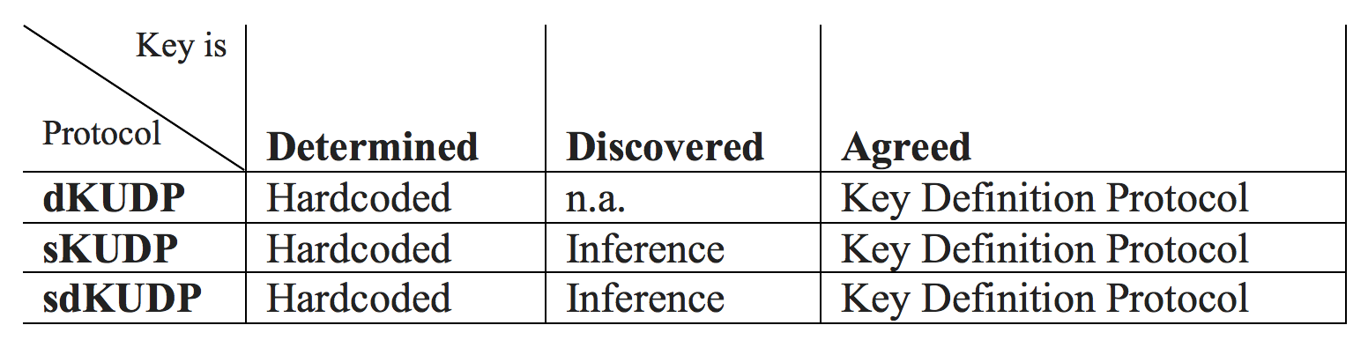
Keyed-UDP
So how can the key length (and type) be detected?

Slide 20
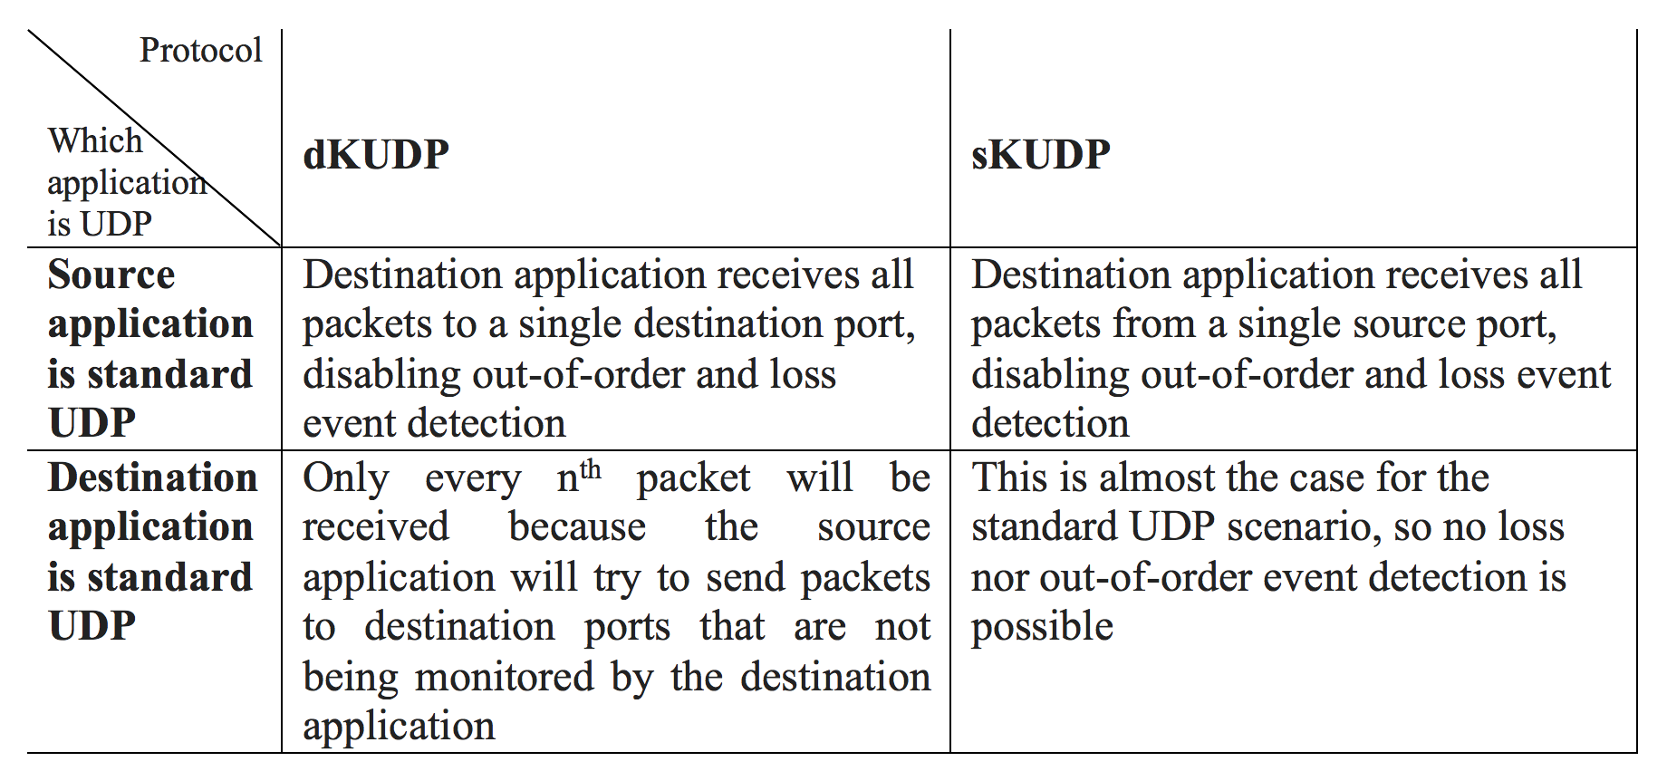
Keyed-UDP
Retro-compatibility with non-KUDP apps?

Slide 21
Keyed-IPv6
What if instead of using port numbers as keys, we use IPv6 addresses?
  it may be feasible, most operating systems allow multiple IPv6 address assignment to an interface…

Slide 22
Keyed-UDP
Pending issues:
  What to do when the receiving app detects losses? (NOP, report back, ask to resend, data imputation - it will depend on the app)
  Increase the complexity of the loss-switch inference algorithm by timestamping the packets at arrival?
  Problems with non-homomorphic NAT-PT machines that are not sufficiently persistent?
  NAT-PT tables overload? / IPv6 routing tables overload?
  Others?

Slide 23
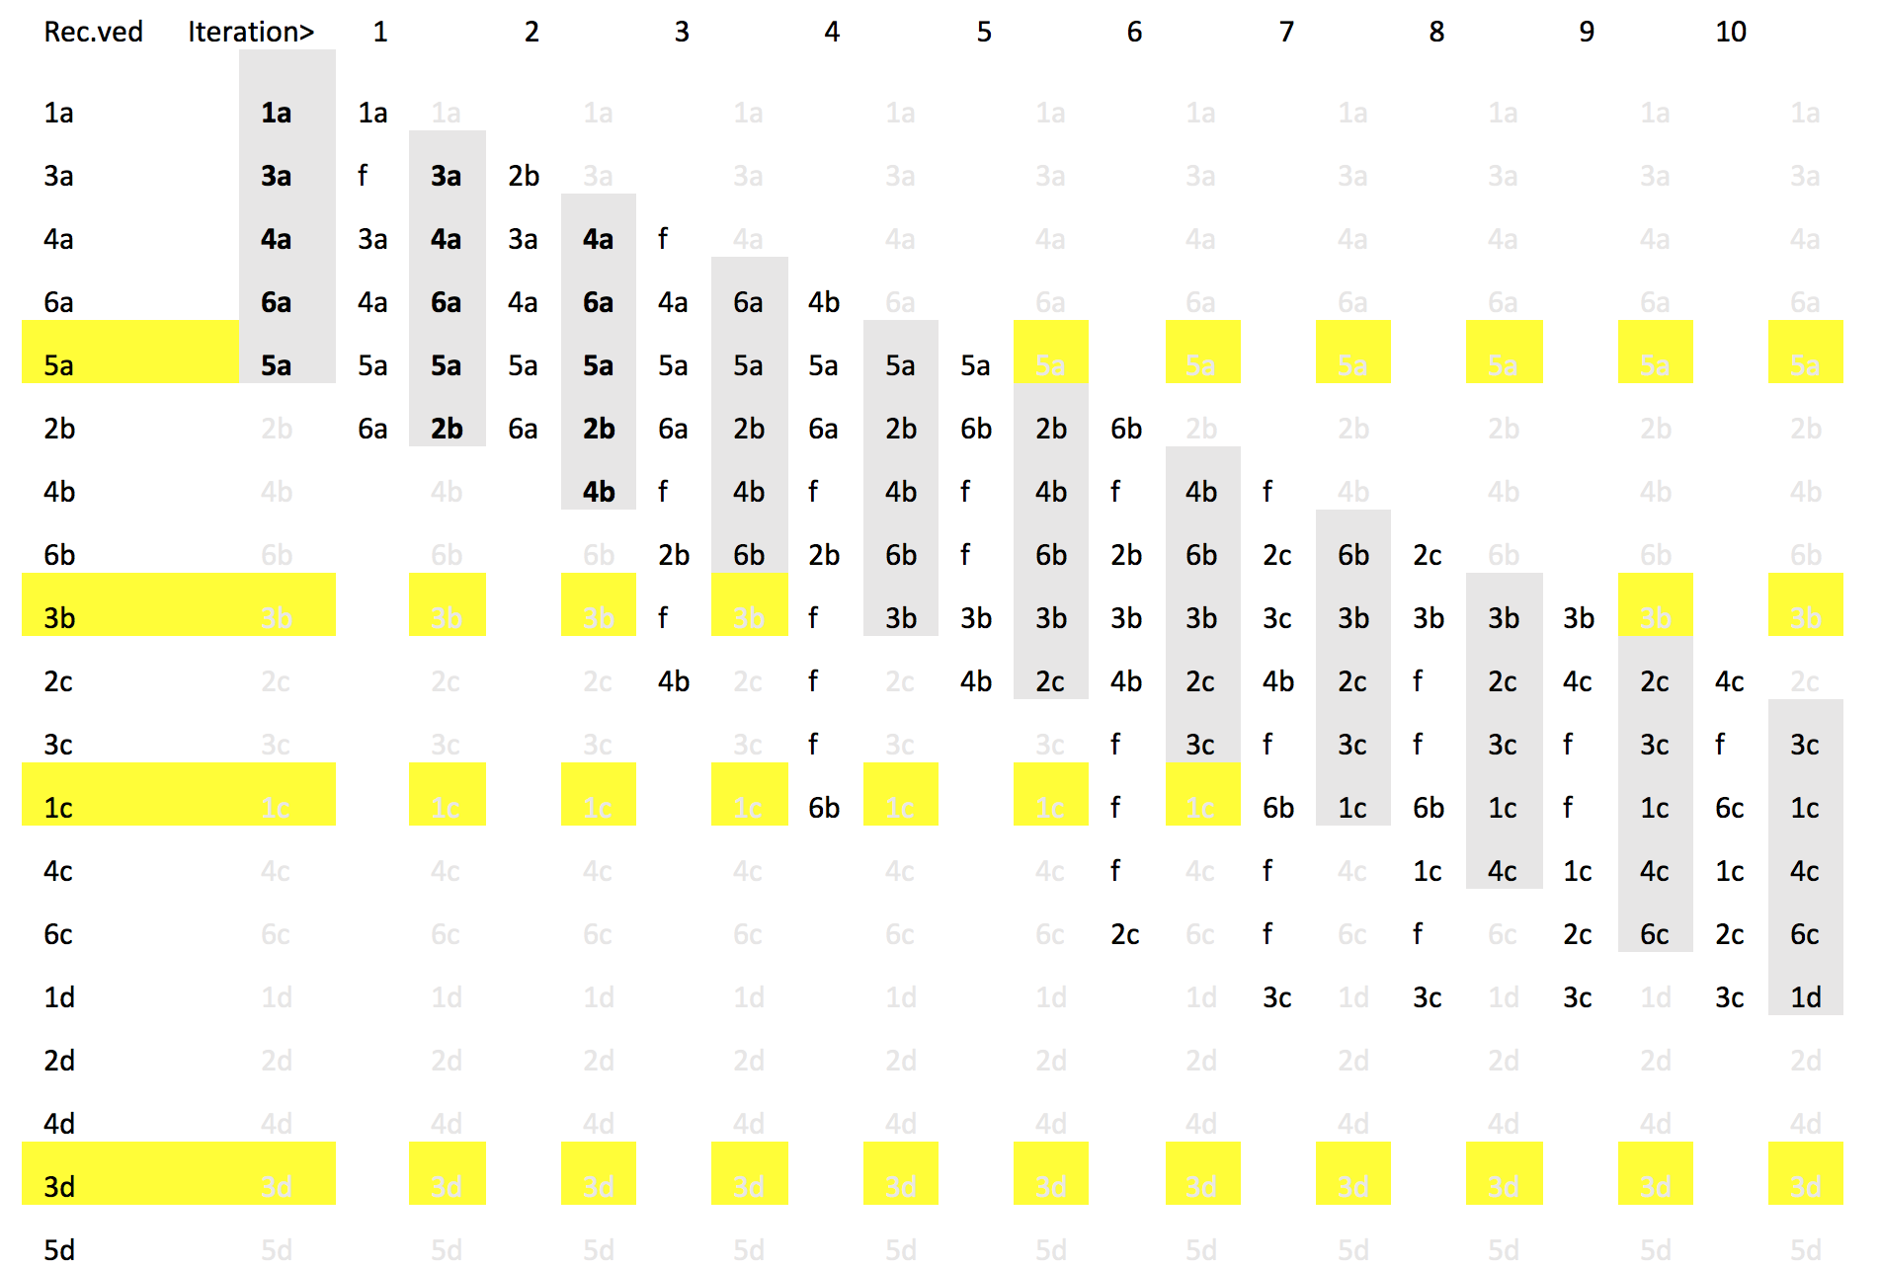
Keyed-UDP
Proposal for a reconstruction algorithm

Slide 24
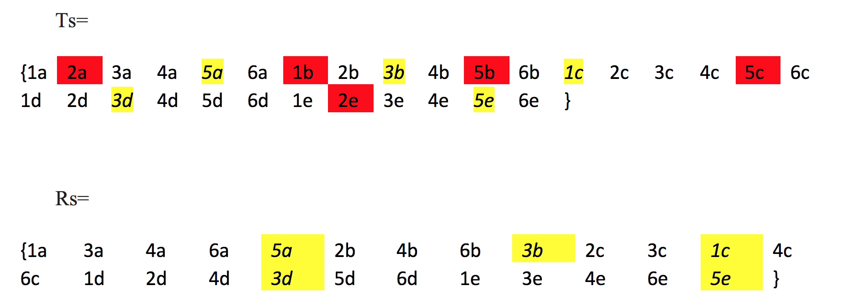
Keyed-UDP

Slide 25
Keyed-UDP

Slide 26
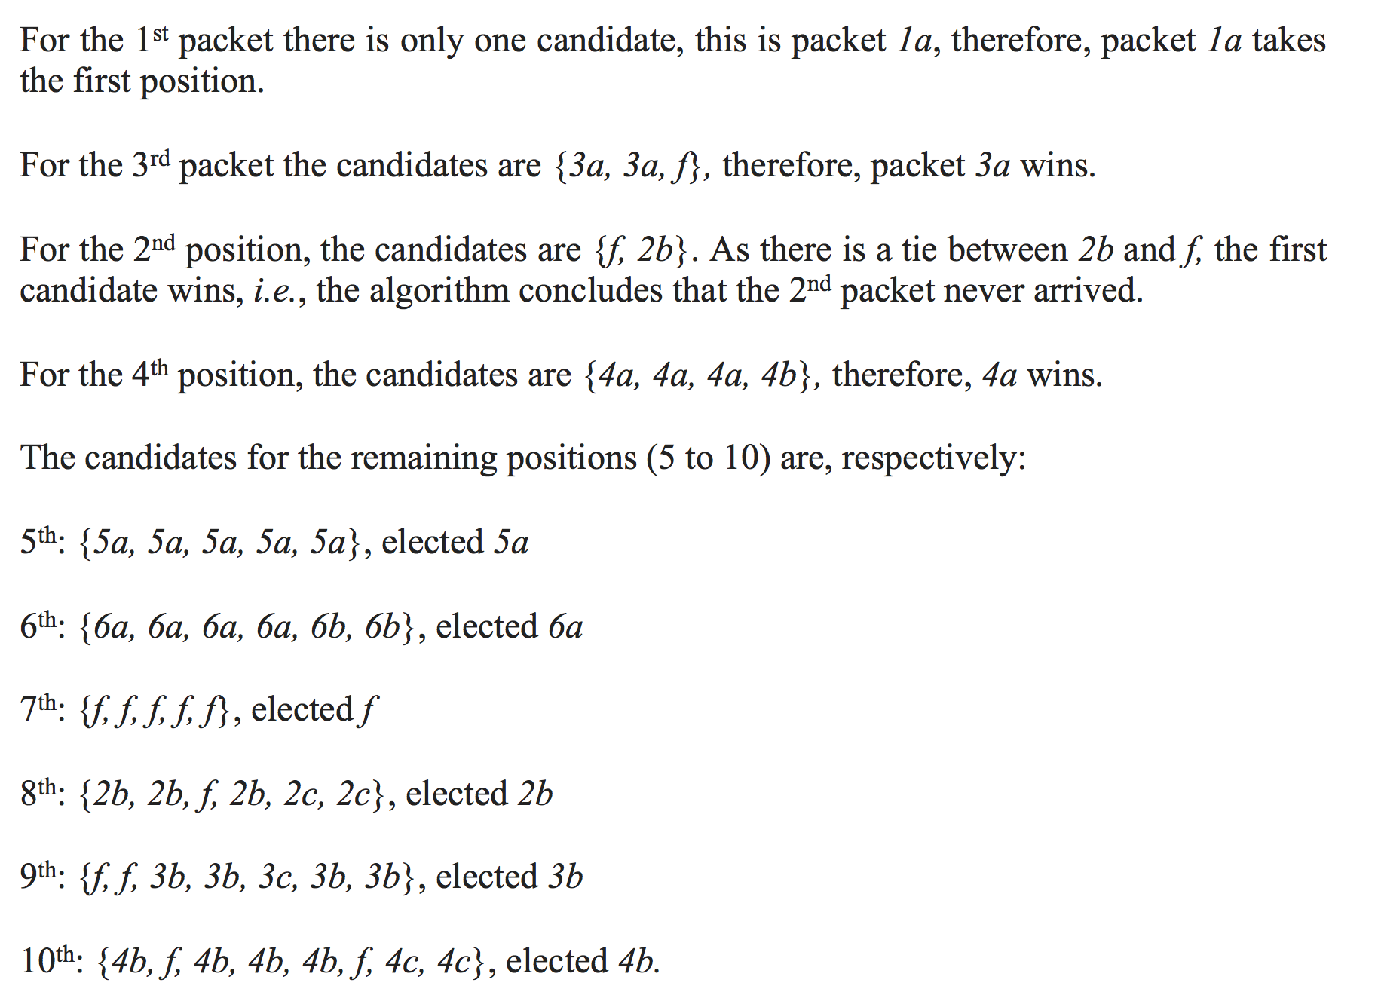
Keyed-UDP

Slide 27
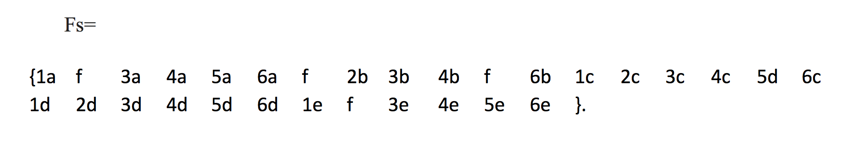
Keyed-UDP
16.7% loss + 20% switches

Slide 28
Keyed-UDP
Application*
Network
Data Link
PHY
Application
UDP
Network
Data Link
PHY
Stream
Reconstruction
Algorithm
KUDP

Slide 29
Finally, Users!
We will be flooded with data from all of our machines
We won’t be able to process it, nor we will be aware of its existence
We will see multi-sensor, multi-location, multi-device, multi-format data only by its impact in our daily lives (a bit like targeted advertising on the email systems)
After the ubiquity of computers, we will have the ubiquity of data, and for users, this will mean that we will need systems that receive, summarise, process, extract relevant features and feed the appropriate algorithms for our own benefit
The following step is to use the data from multiple users to infer and confirm daily living patterns, as to allow its monitoring and training

Slide 30
Fueling the Internet of Everything
will be the Internet of our private lives, our machines, our health and our social interactions
is this scary? a lot!
is this worth the effort? probably yes!

Slide 31
Questions!
Thank you!
Nuno M. Garcia
Instituto de Telecomunicações
University of Beira Interior
ngarcia@di.ubi.pt
This work was supported by National Funding from the FCT - Fundação para a Ciência e a Tecnologia, through the UID/EEA/50008/2013 Project.
The author acknowledges the support of COST Action IC1303 AAPELE - Architectures, Algorithms and Protocols for Enhanced Living Environments

