Slide 1
Configuring CPE for IPv6 Transition Mechanisms
Lee Howard
Retevia
Lee.Howard@Retevia.net
@wleecoyote
Notes:
Story about my morning
I’m going to remind you how mechanisms work, but focus on CPE configuration.
Target audience is ISPs who might be considering deploying a transition mechanism.

Slide 2
Recap
 | NAT64 | 464xlat | DS-Lite | MAP-T MAP-E
Supports IPv4 Apps | No | Yes | Yes | Yes
CPE Support is Common | N/A | No | Yes | No
BR/plat/AFTR (PE) Cost | High | High | High | Low
Notes:
A walk through comparing the pros and cons of each.

Slide 3
Guide to DHCP Examples
Examples assume the provider equipment is already in place and configured
DNS64/NAT64
DS-Lite AFTR
MAP BR
Using ISC DHCP for examples
Any DHCP server can send custom options
Notes:
I’m going to take a huge risk and try to do this as a live demo, but you know how those work.
In fact, I’d originally planned to have a dozen home gateways scattered around the room for people to connect to, so this could be hands-on, but nothing ever works right the first ten times.

Slide 4
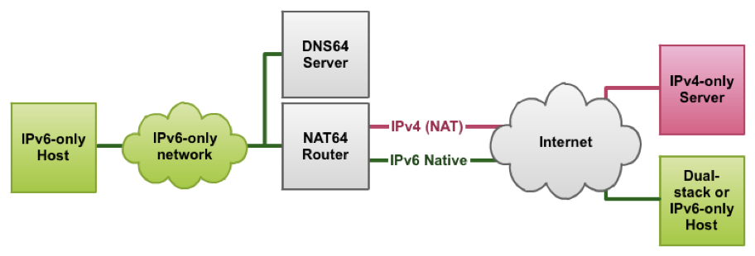
NAT64 + DNS64

Slide 5
NAT64
Provision your DNS64 server as customer’s DNS resolver
/etc/dhcp/dhcpd6.conf
subnet6 2001:67c:64:fefe::/64 {
option dhcp6.name-servers 2a00:8642:2000::53 ;
}
Prefix assigned to user
DNS64 server
Notes:
Open linux term window (SSH is fine)
Service dhcp6 restart
Those of you connected to “Retevia” should see that your IPv6 address is the same, but you can reach some IPv4 stuff now.
Of course, if you have manually configured other name servers, like Google’s, you still have no additional connectivity.

Slide 6
464xlat
First, configure NAT64
On OpenWRT 15.05:
/etc/config/network
config interface clat
option proto 464xlat
Notes:
As an ISP, you can’t just use DHCPv6 to push this configuration option.
If you have TR-069 or other configuration control, you can set it.

Slide 7
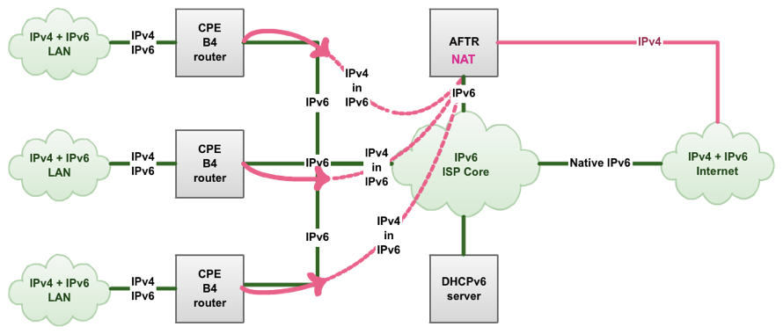
DS-Lite

Slide 8
Dual-Stack Lite
Provision customer with DS-Lite BR
/etc/dhcp/dhcpd6.conf
subnet6 2001:67c:64:fefe::/64 {
option dhcp6.aftr-name aftr1.nl.retevia.net; }
Prefix assigned to user
Name of AFTR (with a AAAA record)
Notes:
# option dhcp6.dslite 2a00:8642:2000:af::1 ;

Slide 9
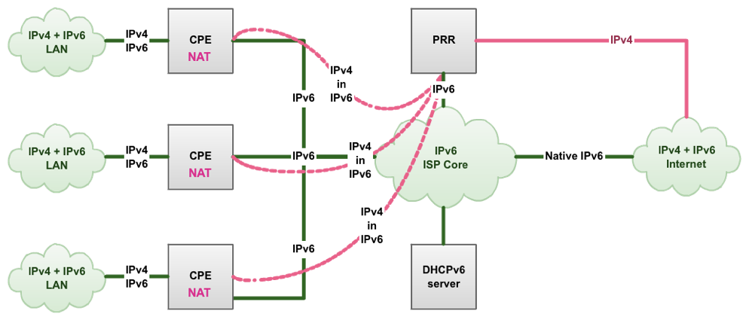
MAP

Slide 10
MAP-T
/etc/dhcp/dhcpd6.conf
subnet6 2001:db8:0:1::/64 {
option dhcp6.map-option code 95 = string;
option dhcp6.map-option 00:59:00:18:00:04:20:c0:00:02:0f:40:20:01:06:7c:00:64:fe:fe:5d:00:04:06:00:00:00:00:5b:00:09:40:2a:00:86:42:20:00:af:55;
}
Outside IPv4 address (192.0.2.0) and mask (32)
IPv6 prefix assigned to user 2001:67c:64:fefe::/64
Prefix of MAP BR Default Mapping Rule
EA bits (Embedded Address bits)
http://6lab.cisco.com/map/MAPnew.php
Notes:
I’m handwaving a lot of the possibilities of MAP, like hub and spoke vs. mesh, and I’ve just picked some values here.
Don’t panic! This long string comes from rfc7598 section 4.
Or use this Cisco tool if your MAP vendor doesn’t provide something else. If you outsource your BRs, you’ll get these config bits from your vendor.
Also, we don’t have this running for demo. Some folks on our team had some health issues that put us far behind.

Slide 11
MAP-E
/etc/dhcp/dhcpd6.conf
subnet6 2001:db8:0:1::/64 {
option dhcp6.map-option code 95 = string;
option dhcp6.map-option 00:59:00:18:00:04:20:c0:00:02:0f:40:20:01:06:7c:00:64:fe:fe:5d:00:04:06:00:00:00:00:5a:00:10:2a:00:86:42:20:00:af:55:00:00:00:00:00:00:00:01;
}
Outside IPv4 address (192.0.2.0) and mask (32)
IPv6 prefix assigned to user 2001:67c:64:fefe::/64
Address of MAP-E BR
EA bits (Embedded Address bits)
http://6lab.cisco.com/map/MAPnew.php

Slide 12
Summary
CPE configuration through normal provisioning systems
Vendor support is an issue, getting better
Notes:
I haven’t seen anything on the Internet comparing how to configure transition mechanisms.
It’s all done through your regular provisioning system, and most are pretty easy.
CPE support is a big problem, but expect vendor updates in the next few months.

Slide 13
DISCUSSION
Further discussion Lee.Howard@Retevia.net

