Slide 1
Paul ANDERSEN
CHAIRMAN, ARIN BOARD OF TRUSTEES
Update

Slide 2
“ARIN, a nonprofit member-based organization, supports the operation of the Internet through the management of Internet number resources throughout its service region; coordinates the development of policies by the community for the management of Internet Protocol number resources; and advances the Internet through informational outreach.”
–ARIN Mission Statement
Notes:
ARIN’s Mission Statement, the source of our strategic plan and initiatives past present and future.

Slide 3
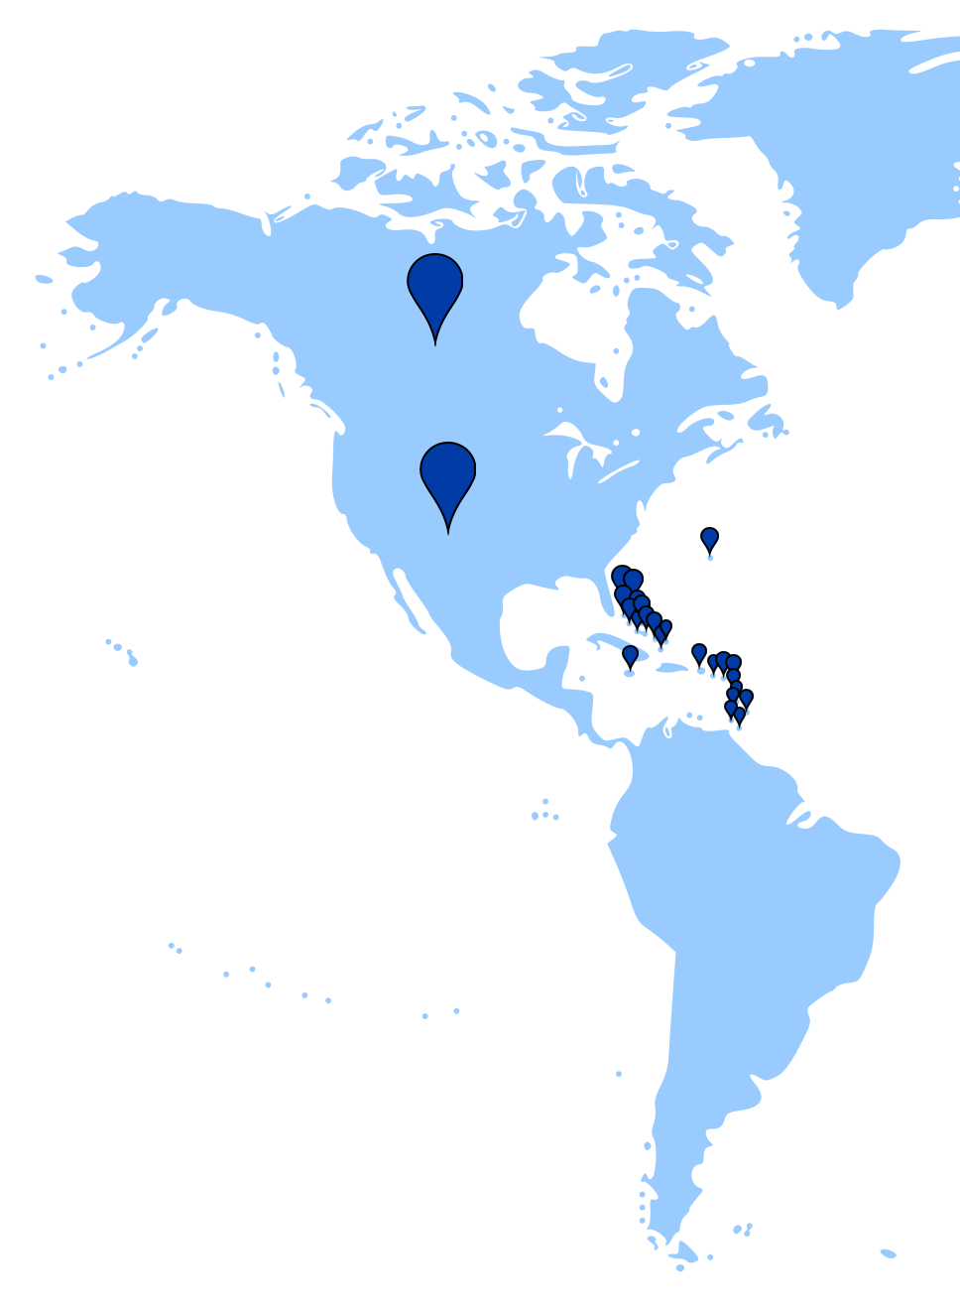
ARIN serves…
The United States
Canada
More than 25 Caribbean and North Atlantic economies
Served Organizations: 37,000+ Contracted customers: 20,000+ Member Organizations: 5,500+
Notes:
ARIN serves the following economies:
Anguilla, Antarctica, Antigua and Barbuda,
Bahamas, Barbados, Bermuda, Canada, Cayman Islands, Dominica, Grenada, Guadeloupe,
Jamaica, Martinique, Montserrat, Saint Barthelemy, Saint Kitts and Nevis, Saint Lucia, St.
Pierre and Miquelon, Saint Vincent and the Grenadines, St. Martin, St. Helena, Turks and
Caicos Islands, Virgin Islands (British),
United States, Puerto Rico, Virgin Islands (US),
Bouvet Island, Heard and McDonald Islands

Slide 4
our focus
Uphold the multi-stakeholder model for management of Internet number resources
Educate the community about ongoing IPv6 adoption and imminent IPv4 obsolescence
Maintain, develop, and enhance functionality of ARIN services as sought by the users and supported by the membership
Coordinate globally to maintain a consistent and highly usable Internet Numbers Registry system
Notes:
As always we are focused on IPv6 awareness and driving adoption.
We have a large role as a thought leader in many fora for Internet governance both inside and outside the ARIN region, and continue to advocate the thus-far-successful community-base multistakeholder model of Internet number resource policy development.
ARIN Online continues to evolve per community and staff feedback to provide the most streamlined, efficient, and friendly user interface possible while meeting our technical and accessibility standards.
We are working on a second customer survey to get a holistic view of the organization’s image and where improvements can be made.
We also have a sharp focus on the accuracy and quality of data in Whois, and the ARIN community has spoken via our PDP and other processes to make it clear that accuracy is paramount when it comes to large ISP management, law enforcement, and so on.

Slide 5
Community Engagement
Eight ARIN on the Road events
Speaking engagements on IPv6 and Whois Data Accuracy
Participation in national and regional Internet coordination & governance fora
Outreach and personal training for government, law enforcement, etc.
Support a very active community consultation and suggestion process
ARIN Bits (our quarterly e-news update)
Increased Caribbean Engagement
Notes:
Our ARIN on the Road event continue to bring new faces to the fold, including a remarkable showing at our recent iteration in San Juan, Puerto Rico.
Outreach is a big part of ARIN, and we strive to keep the community well-informed, wherever they may be.
ARIN has a number of Internet Governance participation and liaising opportunities we take advantage of to keep our community educated on the state of Internet affairs as well as keeping their voice a part of the conversation. ARIN maintains a keen interest and established position as an Internet governance thought leader, fostering working relationships on a global scale, being a key resource for Internet governance debate participants, supporting cooperation and direct involvement alongside governments and international organizations to share and strengthen global knowledge about Internet governance issues.
We continue to address any knowledge gaps or awareness needs throughout the region via speaking engagements centered around IPv6 awareness and Whois data accuracy.
Our consultation and suggestion process remains a valuable feedback collection mechanism.
ARIN Bits, a quarterly e-news update, saw its first issue distributed via email to our community in June, and will continue quarterly to keep everyone in the loop on the latest happenings at ARIN.

Slide 6
Caribbean Engagement
Major focus on Caribbean Internet development
New Hire: Caribbean Outreach Liaison (Bevil Wooding)
Facilitating participation with ARIN across a range of areas (Policy Development Discussions, Outreach, Capacity Building)
Continuing Collaboration with:
Caribbean Telecommunications Union (CTU)
CaribNOG
Caribbean Internet Governance Forum
CANTO
Notes:
We engage with various organizations in the Caribbean specifically, such as CANTO, the Caribbean Telecommunications Union, CaribNOG, and others, to maximize their inclusion in both policy development and stakeholder engagement throughout the remainder of the ARIN region. We also work with entities in the Caribbean like CANTO, Caribbean IGF and the like on matters of international Internet governance in areas served by both ARIN and LACNIC.

Slide 7
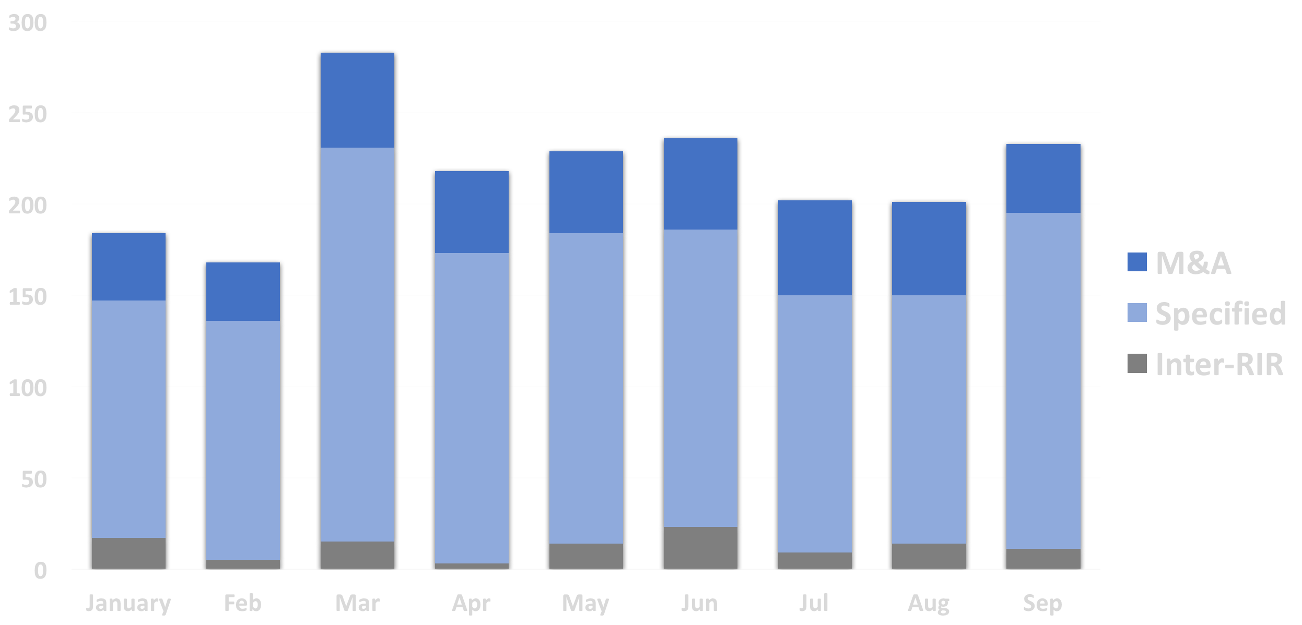
Transfers

Slide 8
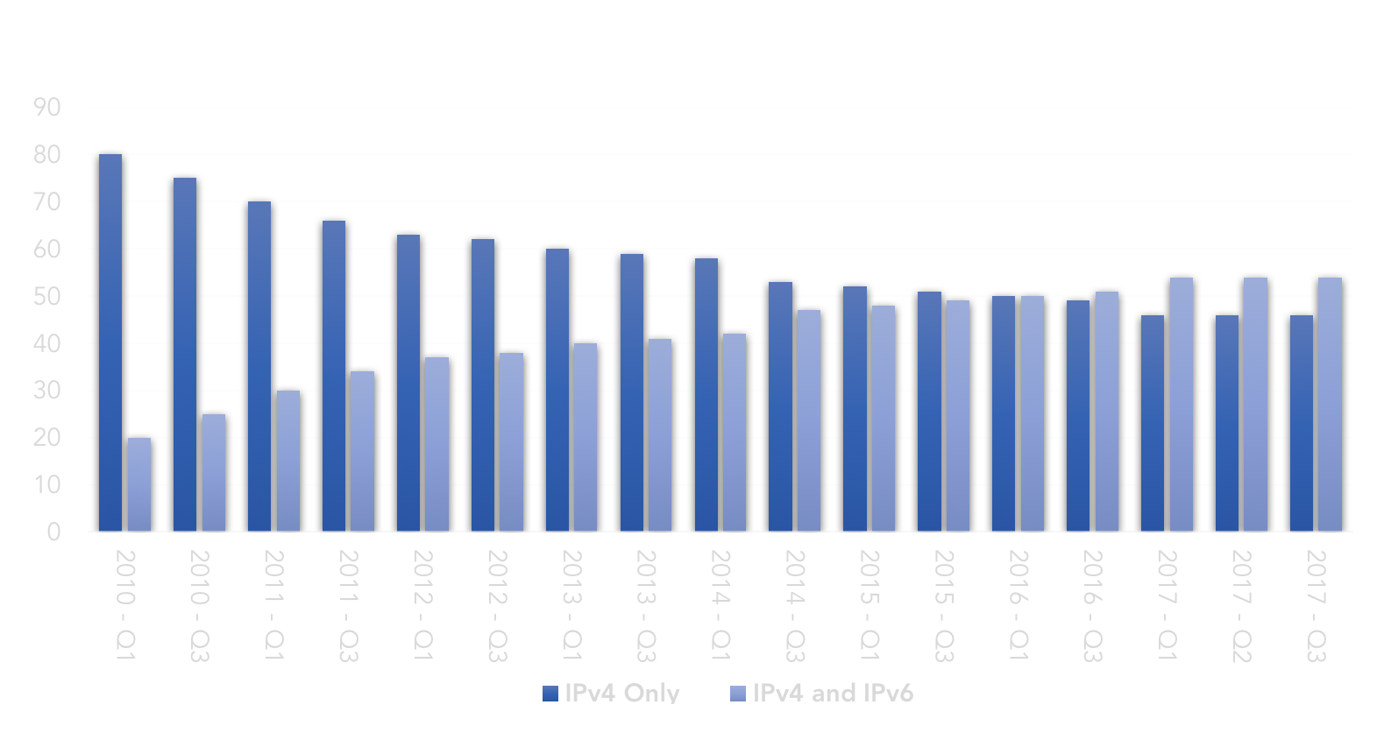
ISPs with IPv4 and IPv6

Slide 9
Recently implemented policies (8 AUGUST)
ARIN-2016-3: Alternative simplified criteria for justifying small IPv4 transfers
Allows organizations to double their resources via transfer (up to a /16) once every six months if they have utilized 80% of their IPv4 number resources.
ARIN-2016-9: Streamline Merger & Acquisition Transfers
Allows acquiring entities to complete Merger and Acquisition Transfers with ARIN with proof of acquisition only (no need assessment required)
Notes:
Our most recent policy implementation included two policies, one allowing orgs to double their holdings upon proof that 80% of their current holdings are in use, and another which serves to remove a second needs justification in the case of mergers and acquisitions where resources have already been justified under ARIN Policy

Slide 10
the latest
ARIN Named a “Top place to work” in the Washington DC Area (Washington Post)
Policy Development Process Readiness Course (Webinar/Podcast/E-publication)
Website Redesign Underway – User interface feedback sessions at ARIN 40
Ongoing ARIN Online enhancements
Upcoming Customer Survey
Notes:
We are proud to have been named one of the Washington Post’s Top Workplaces in the Small Business category, a recognition owed to the skilled and passionate staff ARIN maintains.
We are delving into some new and interesting ways to make our Policy Development Process accessible, attractive, and top of mind throughout the ARIN region and beyond, and as such we are developing a course as it were, on PDP readiness. This course takes the form of a video series, audio podcast, e-publication, and slide deck, and we encourage you to keep an eye on our home page and mailing list for updates.
We are in the fairly early stages of a website redesign that will modernize, streamline, and improve many of the ways our community utilizes both ARIN.net and ARIN Online, our customer portal.
As mentioned, we will be conducting a customer survey ___insert timeframe here___. We have completed one in the past, March 2014 to be exact, and have seen great work come as a result of the suggestions therein, and we hope to see even more results from the second iteration.
ARIN Online enhancements continue as we move toward our new website, based largely on community feedback. Recent improvements include transfer statistics improvements, many menu and page redesigns, POC validation streamlining, and more.

Slide 11
Upcoming ARIN Meetings
ARIN 42
Vancouver | 4-5 October 2018
Notes:
2018 will see two Public Policy and Members Meetings, one in Miami in April as a standalone, and one in Vancouver Canada in October in conjunction with NANOG. Note that our regional residency requirement has been lifted on ARIN Fellowships, so we encourage any of you who have not yet made it to an ARIN meeting to apply for and take advantage of the program.

Slide 12
?

