Slide 1
Route Servers: An AMS-IX Introspective

Slide 2
Basic Route Server Challenges
Problem #1 (ca. 2008): Simplify large scale EBGP interconnection (peering) across a Layer 2 network
Solution #1: Deploy one (or more) intermediate broker systems, acting similarly to IBGP route reflectors. Call them route servers.*
*Now RFC7947

Slide 3
Basic Route Server Challenges
Problem #2 (a bit later): Support peer routing policies: Peers want to exchange prefixes with a subset of all route server peers.
Diverse Kludges Solutions #2: 1. IRR based policies 2. BGP community parsing 3. Client-Accessible database (we ended up with 1. and 2.)*
*Still part of RFC7947

Slide 4
Routing Hygiene
Problem #3: Filter out unwanted prefixes
Solution #3: Basic Filtering implemented (Bogons, Martians, RFC1918, native AS, next-hop sanity)

Slide 5
Routing Hygiene
Problem #4 (ca. 2013): Filter out more unwanted prefixes
Solution #4: Filter based on IRR data and RPKI

Slide 6
Route Server politics
Problem #5: Introduce solution #4 in a non controversial way. ”Filtering prefixes based on BCPs is OK, but asking other institutions (e.g. RIPE) about prefix validity may attract ire from customers not acknowledging institution authority or value. It might also inadvertently advertise capability to non-community stakeholders”

Slide 7
Route Server politics
Solution #5 (2015): Circumvent problem #5 by introducing four choices of filtering (IRR+RPKI, IRR only, RPKI only, no filtering, just tagging) in a second set of route servers. Add all solutions, up to #4 to that new set. Call it Falcon route servers. Make tagging the default filtering option.

Slide 8
Route Server politics
Solution #5 (cont’d): Bet internally as to whether customers are interested in the new route servers or not, based on the uptake in a month’s time. There was ☺

Slide 9
Route Server politics
Problem #6: Customers/members informally suggest to backport features to the Legacy route servers. Internal discussion ensues once again. Is it OK to do that?

Slide 10
Route Server politics
Solution #6 (2017): Bring the question back to the customer/member base. Get feedback. Customers voicing opinion were all in favor of doing so, and with IRR+RPKI the default filtering mechanism.

Slide 11
Legacy Route Server ”falconization”™
Backporting of features went live on Friday, October 20th, 2017.
No traffic loss detected, although advertised prefixes (with IRR+RPKI filtering) went from ~165K to ~68K.

Slide 12
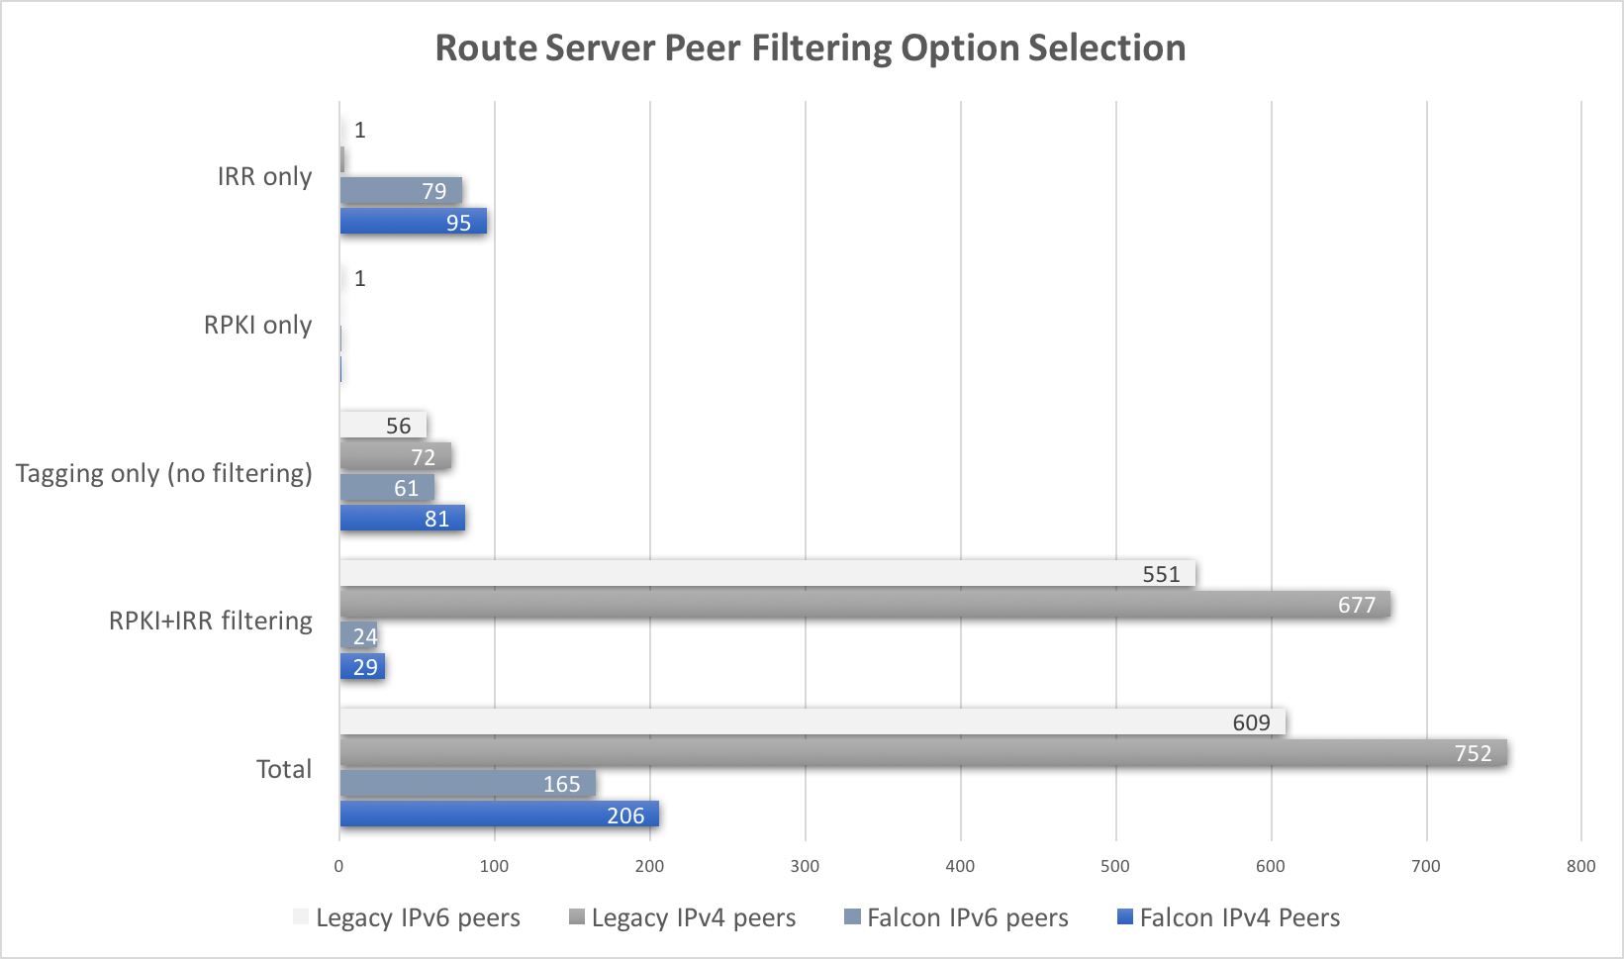

Slide 13
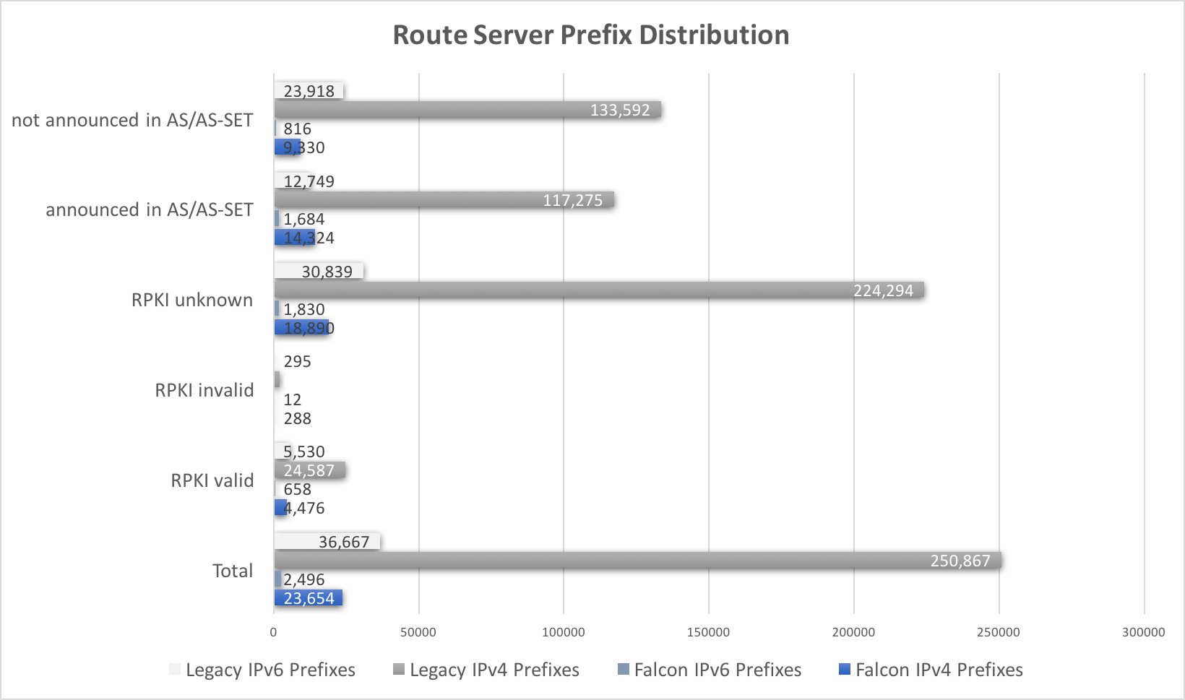

Slide 14
Questions?

